Slide 1

Crosswalk from Cancer Registry to OMOP Oncology Module
Rimma Belenkaya

Slide 2
Outline
ETL of Diagnoses
ETL of Diagnostic Modifiers
Value as concept
Value as number
Derivation of disease Episodes
First occurrence

Slide 3
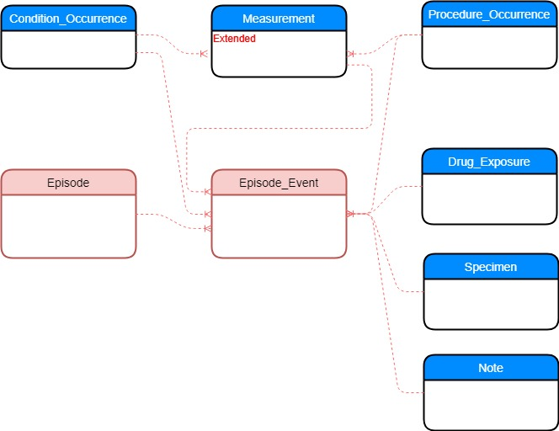
Oncology Model in OMOP CDM
Diagnosis,
pre-coordinated concept representing histology and topography
Modifier representing diagnostic and treatment features
Underlying events
Disease and Treatment
Episodes
Connection between
Episode and
Underlying events

Slide 4
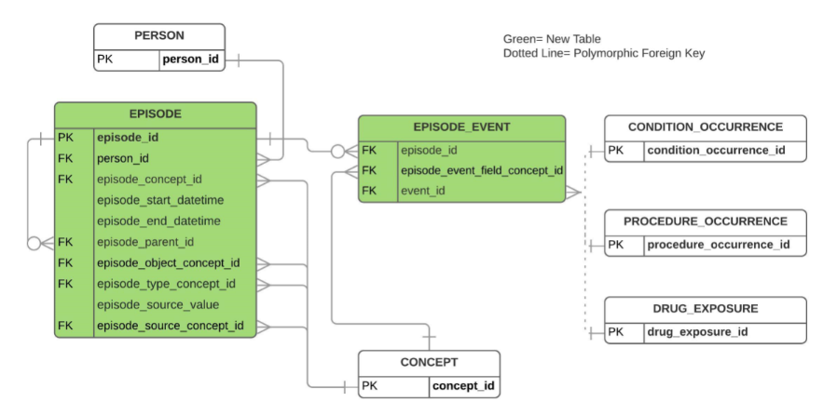
EPISODE Model

Slide 5
Cancer Registry Patient Record Sample
Field# | NAACCR Item # | NAACCR Item Name | NAACCR Value | Value Description
1 | 20 | Patient ID Number | 123456
2 | 400 | Primary Site | C50.9 | Breast, NOS
3 | 522 | Histologic Type ICD-O-3 | 8010/3 | Carcinoma, NOS
4 | 390 | Date of Diagnosis | Jun-9-2019
5 | 410 | Laterality | 1 | Right: origin of primary
6 | 440 | Grade | 4 | Grade IV
7 | 390 | Summary Stage 2018 | 2 | Regional by direct extension only

Slide 6
Source Table Structure
Field Name | Field Type | Required | Field Description
person_id | integer | Yes | Patient ID
record_id | varchar(100) | Yes | Unique primary tumor occurrence ID
naaccr_item_number | integer | Yes | NAACCR Item #
naaccr_item_value | varchar(100) | Yes | NAACCR item value
histology_topography | varchar(20) | Yes | Concatenated histology and topography

Slide 7
Source Data Sample
person_id | record_id | naaccr_item_number | naaccr_item_value | histology_site
1 | http://mskcc.org/tumorregistry/1_000001 | 400 | C50.9 | 8010/3-C50.9
1 | http://mskcc.org/tumorregistry/1_000001 | 522 | 8010/3 | 8010/3-C50.9
1 | http://mskcc.org/tumorregistry/1_000001 | 390 | Jun-9-2019 | 8010/3-C50.9
1 | http://mskcc.org/tumorregistry/1_000001 | 410 | 1 | 8010/3-C50.9
1 | http://mskcc.org/tumorregistry/1_000002 | 2800 | 30 | 8010/3-C50.9
1 | http://mskcc.org/tumorregistry/1_000002 | 400 | C50.9 | 8010/3-C50.9
1 | http://mskcc.org/tumorregistry/1_000002 | 522 | 8010/3 | 8010/3-C50.9
1 | http://mskcc.org/tumorregistry/1_000002 | 390 | Jun-9-2019 | 8010/3-C50.9
1 | http://mskcc.org/tumorregistry/1_000002 | 410 | 3 | 8010/3-C50.9
Map field names in your source to NAACCR item ids
Site and histology must be converted to the following format: C50.9 and 8010/3
Add histology_site field to the source data (will simplify ETL)

Slide 8
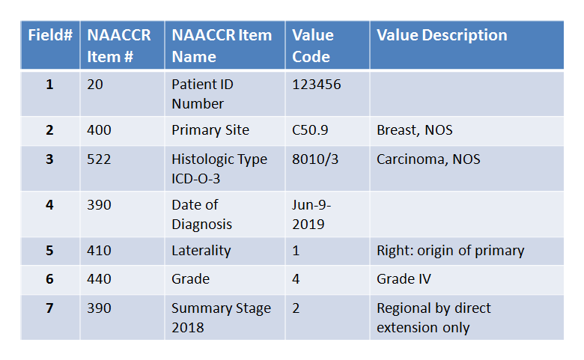
Crosswalk for Diagnosis
Cancer Registry patient record
CONDITION_OCCURRENCE record
CONCEPT: source concept for diagnosis
CONCEPT_RELATIONSHIP
CONCEPT: standard concept for diagnosis

Slide 9
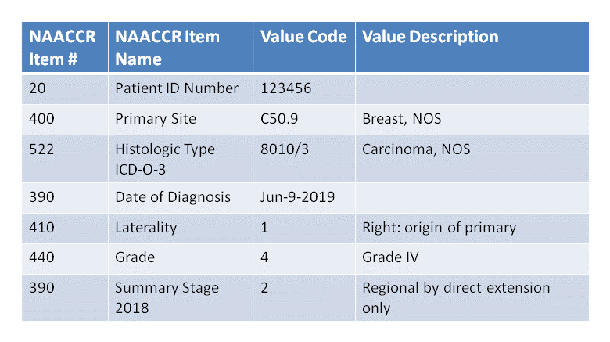
Crosswalk for Diagnostic Modifiers: value as concept
Cancer Registry patient record
CONDITION_OCCURRENCE record
CONCEPT: source concept for diagnosis
CONCEPT_RELATIONSHIP
CONCEPT_RELATIONSHIP
CONCEPT: concept for diagnostic schema
Measurement record
CONCEPT: standard concept for value
CONCEPT_RELATIONSHIP
CONCEPT_RELATIONSHIP
CONCEPT: standard concept for laterality
CONCEPT: standard concept for date

Slide 10
NAACCR Numeric Items in Vocabulary
NAACCR Item #2800 ‘CS Tumor Size’
Concept
Concept Relationship
Field | Value
concept_id | 4325345
concept_name | CS Tumor Size
concept_code | June 9, 2019
vocabulary_id | NAACCR
domain_id | Measurement
Field | Value | Description
concept_id_1 | 4325345 | CS Tumor Size
concept_id_2 | 999991 | Numeric
relationship_id | has type
Field | Value | Description
concept_id_1 | 4325345 | CS Tumor Size
concept_id_2 | 999992 | mm
relationship_id | has units

Slide 11
NAACCR Numeric Items in Vocabulary
Scenario | NAACCR Values | Description
1 | 001-988 | 001 - 988 millimeters (mm) (Exact size to nearest mm)
2 | 989 | 989 mm or larger
3 | 991 | Described as "less than 1 centimeter (cm)"
4 | 992 | Described as "less than 2 cm," or "greater than 1 cm," or "between 1 cm and 2 cm"
Concept
Concept_Numeric
Field | Value | Value | Value
concept_id | 4325346 | 4325347 | 4325348
concept_name | 989 mm or larger | less than 1 cm | Between 1 and 2 cm
concept_code | 2800@989 | 2800@991 | 2800@992
vocabulary_id | NAACCR | NAACCR | NAACCR
domain_id | Meas Value | Meas Value | Meas Value
Field | Value | Value | Value | Value
concept_id | 4325346 | 4325347 | 4325348 | 4325348
concept_as_value | 989 | 1 | 1 | 2
concept_unit_id | cm | cm | cm | cm
operator_concept_id | Equal of greater | Equal of less | Equal of greater | Equal of less

Slide 12
SQL for ETL of Diagnosis and Modifiers
Insert a CONDITION_OCCURRENCE record
Insert the first disease occurrence modifier into MEASUREMENT
Insert diagnostic modifiers with values as concepts into MEASUREMENT
Ingest diagnostic modifiers with values as number into MEASUREMENT

Slide 13
Derivation of First Occurrence Episode
CONDITION_OCCURRENCE record
EPISODE record
EPISODE_EVENT record

Slide 14
SQL for the First Occurrence Episode
Insert an EPISODE record
from CONDITION_OCCURRENCE based on the First Occurrence modifier
Insert EPISODE_EVENT record
to connect EPISODE and CONDITION_OCCURRENCE records
Insert a set of “clean” EPISODE modifiers into MEASUREMENT
based on the CONDITION modifiers

